Slide 1
Making Games in Casanova
Giuseppe Maggiore Pieter Spronck Renzo Orsini Michele Bugliesi Mohamed Abbadi Enrico Steffinlongo

Slide 2
Agenda
The Casanova language
Assessing a language
Game development activities

Slide 3
Making games
Fun
Interesting
Serious games
Research games/simulations
Expensive

Slide 4
What is Casanova
Making game development less expensive
Indie games
Research games

Slide 5
The Casanova language
World definition
Rules
Scripts

Slide 6
Bouncing Balls/1
type World = {
Balls : Var<List<Ball>>
}
rule Balls(world:World,dt:float<s>) =
[for b in world.Balls do
if (b.Position).X < world.ScreenSize.X + 100.0<m> then
yield b]

Slide 7
Bouncing Balls/2
type Ball = {
Position : Vector2<m>
Velocity : Vector2<m/s>
Sprite : DrawableSprite
}
rule Position(world:World,self:Ball,dt:float<s>) =
if self.Position.Y < 0.0<m> then self.Position.X * Vector2(1.0,0.0)
else self.Position + self.Velocity * dt
rule Velocity(world:World,self:Ball,dt:float<s>) =
if self.Position.Y < 0.0<m> then self.Velocity * Vector2(1.0,-0.8)
else self.Velocity + Vector2<m/s^2>.UnitY * 9.81f * dt
rule Sprite.Position(self:Ball,dt:float<s>) =
self.Position * Vector2<pixel/m>.One

Slide 8
Bouncing Balls/3
let world =
{
Balls = []
}

Slide 9
Bouncing Balls/4
let main =
repeat_(
{
let vx = random_range 15.0<m/s> 150.0<m/s>
let vy = random_range -30.0<m/s> 5.0<m/s>
world.Balls :=
{
Position = Vector2<m>(-100.0<m>, 50.0<m>)
Velocity = Vector2<m/s>(vx, vy)
Sprite = DrawableSprite.Create(
default_layer,
Vector2<pixel>.Zero,
Vector2<pixel>(0.2f<pixel>),
"ball")
} :: world.Balls
wait (random_range 1.0<s> 3.0<s>)
})

Slide 10
Bouncing Balls/5
let input =
[
{ return is_key_down Keys.Escape } =>
{ return exit() }
]

Slide 11
Assessing a language
Surprisingly hard
Performance ok
Verbosity almost ok
Expressive power not interestingly
We have to build stuff and see how well it comes out

Slide 12
Game development activities
defining a player avatar, handling his input and his shooting
spawning obstacles randomly
handling collisions between projectiles and obstacles
representing the properties of a static map (cave) divided in rooms and cells
handling monsters and their (rudimentary) AI
active entities such as bases or buildings that produce and consume units
selection-based input mechanisms.

Slide 13
Tested games
Shooter
RPG
RTS

Slide 14
Avatar
type Cannon = {
Sprite : DrawableSprite
Angle : float<rad>
MoveLeft : var<bool>
MoveRight : var<bool> }
rule Angle(world,self,dt) =
self.Angle + if self.MoveLeft then dt
elif self.MoveRight then -dt
else 0.0<rad>
rule MoveLeft(world,self,dt) = false
rule MoveRight(world,self,dt) = false
rule Sprite.Rotation(world,self,dt) = self.Angle
{ return is_key_down Keys.Left } => { state.Cannon.MoveLeft := true },
{ return is_key_down Keys.Right } => { state.Cannon.MoveRight := true }

Slide 15
Shooting
{ return is_key_down Keys.Space } =>
{
state.Projectiles.Add
{ Sprite = { Path = "projectile.jpg"
Layer = world.Sprites }
Position = vector(50.0<, 0.)
Velocity = vector2(cos(state.CannonAngle),
sin(state.CannonAngle))
Colliders = [] }
wait 0.1<s>
}

Slide 16
Spawning
repeat {
wait (random(1.0<s>,3.0<s>))
state.Asteroids.Add …
}

Slide 17
Collisions
type World = {
Asteroids : var<list<Asteroid>>
… }
rule Asteroids(world,dt) =
[a | a <- state.Asteroids &&
a.Colliders.Length = 0 &&
a.Position.Y < 100.0<m>]
type Asteroid =
…
rule Colliders(world,self,dt) =
[x | x <- world.Projectiles &&
distance(self.Position, x.Position) < 10.0f]

Slide 18
Rooms and cells
type Room = {
Cells : list<list<Cell>>
Monsters : list<Monster> }
rule Monsters(world,self,dt) = [m | m <- self.Monsters && m.Health > 0]
type Cell = {
Position : Vector2<m>
Sprite : DrawableSprite
Room : ref<Room>
HasPlayer : bool
Monsters : list<ref<Monster>>
Door : Option<ref<Room>>
Neighbours : list<ref<Cell>> }
rule HasPlayer(world,self,dt) = world.Player.Position = self
rule Monsters(world, self, dt) =
[m | m <- world.CurrentRoom.Monsters && m.Health > 0 && m.Position = self]

Slide 19
Monsters
type Monster = {
Position : var<ref<Cell>>
Sprite : DrawableSprite
Health : int
Damage : var<int>
MoveTarget : var<ref<Option<Cell>>
PositionDelta : Vector2 }
member Movement(world,self,dt,on_arrived,on_moving) =
match self.MoveTarget with
| Some target ->
if distance(self.Position.Position + self.PositionDelta, target.Position) < 0.1 then
on_arrived target
else on_moving()
| None -> on_moving()
rule Health(world,self,dt) =
if self.Position.HasPlayer && world.UpdateNow then
self.Health - world.Player.Damage * random(1,4)
else self.Health
rule Position(world,self,dt) =
Movement(world,self,dt,id,fun () -> self.Position)
rule MoveTarget(world,self,dt) =
Movement(world,self,dt,fun () -> None,fun () -> self.MoveTarget)
rule PositionDelta(world,self,dt) =
Movement(world,self,dt,
fun () -> self.PositionDelta + dt * normalize(target.Position - self.Position.Position),
fun () -> self.PositionDelta)
rule Sprite.Position(world,self,dt) = self.Position.Position + self.PositionDelta

Slide 20
Monsters AI
let monster_AI (monster : Monster) =
repeat {
if monster.Health > 0 then
if monster.MoveTarget = None then
let target_cell = …
do monster.MoveTarget := Some target_cell) }
|| { wait_condition (world.CurrentRoom <>
monster.Position.Room)

Slide 21
Active entities
type Planet = {
Owner : Player
Armies : var<int<Ship>>
FractionalArmies : float<Ship>
AttackingFleets : list<ref<Fleet>>
ReinforcingFleets : list<ref<Fleet>>
… }
rule Owner(world,self,dt) =
if self.Armies <= 0 && self.AttackingFleets.Length > 0 then
self.AttackingFleets[0].Owner
else self.Owner
rule Armies(world,self,dt) =
if self.Armies <= 0 then
sum [a.Armies | a <- self.AttackingFleets && a.Owner = self.AtackingFleets[0].Owner]
else
let damages = sum[random(1,3) | f <- self.AttackingFleets] * state.TickBattles
let reinforcements = sum[f.Armies | f <- self.ReinforcingFleets]
self.Armies + int(self.FractionalArmies) - damages + reinforcements
rule FractionalArmies(world,self,dt) =
self.FractionalArmies + (dt * self.Production) - floor(self.FractionalArmies)
rule AttackingFleets(world,self,dt) =
[f : f <- state.Fleets && f.Target = self && f.Owner <> self.Owner && f.Arrived]
rule ReinforcingFleets(world,self,dt) =
[f : f <- state.Fleets && f.Target = self && f.Owner = self.Owner && f.Arrived]

Slide 22
Selection and sending
{ return mouse_clicked_left() } => {
let mouse = mouse_position()
let clicked =
[p | p <- world.Planets && distance(p.Position,mouse) < 10.0 &&
p.Owner = Human]
if clicked <> [] then return Some(clicked.Head)
else return None } => fun p -> { world.SourcePlanet := Some(p) },
{ return mouse_clicked_right() && world.SourcePlanet <> None } => {
let mouse = mouse_position()
let clicked = [p | p <- world.Planets && distance(p.Position,mouse) < 10.0]
if clicked <> [] then return Some(clicked.[0],world.SourcePlanet.Value)
else return None } => fun (source,target) -> { mk_fleet source target }

Slide 23
Assessment

Slide 24
Assessment/2

Slide 25
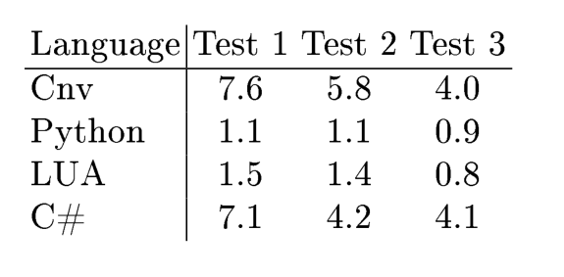
Assessment/3

Slide 26
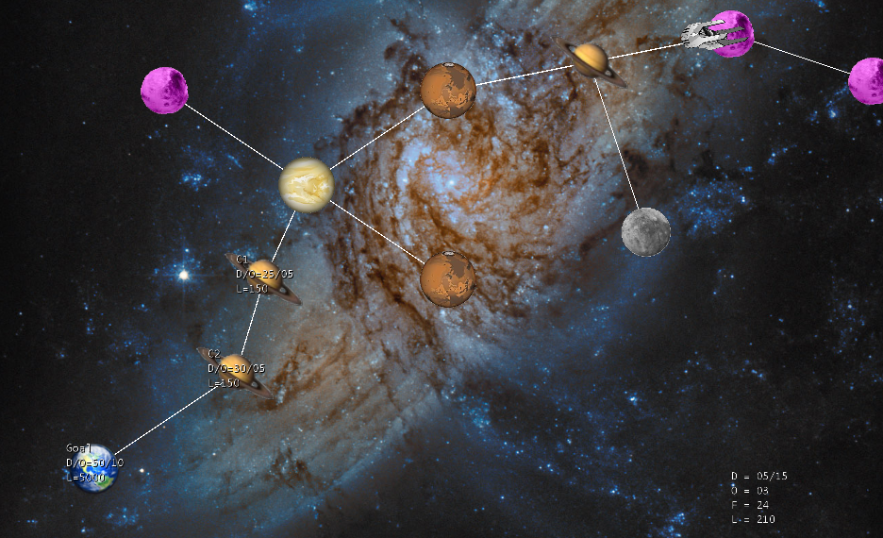
Future Work
Research Games
AI
Networking
3D Support

Slide 27
Conclusions
Games are interesting, but hard to make
Specialized languages can help
Harder at first
More general support for exotic features
Casanova is such a take
Expressive
Good performance

Slide 28
THANK YOU
giuseppemag@gmail.com http://casanova.codeplex.com

